Slide 1
Interconnect Modeling Status
Draft 1
Walter Katz
…
IBIS Summit, DesignCon
January 31, 2013

Slide 2
Supporters
…

Slide 3
Overview
History of Presentations
Assumption is that the EMD concepts can satisfy the needs of the IBIS community from Die to Die
On-Die Models
IBIS 5.1 Limitation
The IC Vendor Needs to Partition the 5.1 Buffer into a IBIS-ISS or Tstonefile On-Die Interconnect and a Different 6.0 Buffer
Conclusion

Slide 4
History of Presentations
IBIS EMD Pre vs Post, Requirements
  http://www.eda.org/ibis/interconnect_wip/IBIS_EMD_12-05-2012.pdf
Package EBD/EMD
  http://www.eda.org/ibis/adhoc/interconnect/Package_EBD_EMD.pptx
Electronic Module Description Specification, Draft 0
  http://www.eda.org/ibis/adhoc/interconnect/EMD.docx
Die-to-Die Connections in EMD
  http://www.eda.org/ibis/adhoc/interconnect/Die2Die.pdf
MCP and EMD ...
  E-Mail sent Fri 12/14/2012 12:39 PM
  LINK TBD

Slide 5
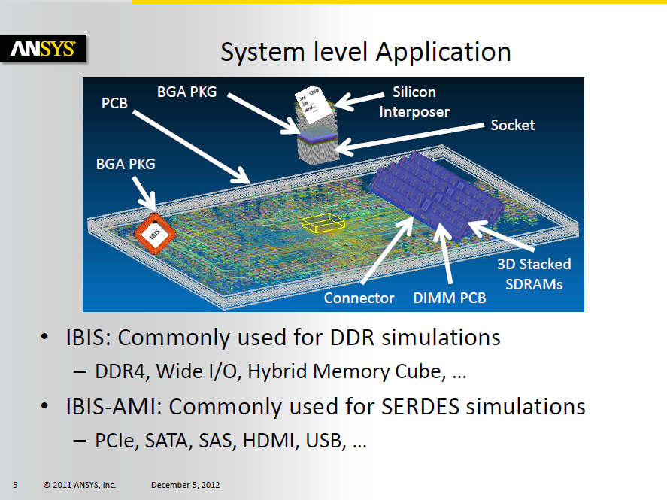
IBIS EMD Pre vs Post, Requirements

Slide 6
One Package Interconnect View
Pads
Pins
A1 DQ1
D.DQ1
A2 DQ2
D.DQ2
A3 DQ3
D.DQ3
A4 DQ4
D.DQ4
A5 DQ5
D.DQ5
D1.VDD
B1 VDD
B2 VDD
D2.VDD
D3.VDD
B3 VDD
D4.VDD
D5.VDD
D6.VDD

Slide 7
One Die Interconnect View
Pads
Buffers
D.DQ1
B.DQ1
D.DQ2
B.DQ2
D.DQ3
B.DQ3
D.DQ4
B.DQ4
D.DQ5
B.DQ5
D1.VDD
D2.VDD
Pu.DQ1
D3.VDD
Pu.DQ2
D4.VDD
Pu.DQ3
Pu.DQ4
D5.VDD
Pu.DQ5
D6.VDD

Slide 8
Electronic Module Description (EMD)
MCM is a Package with Multiple Die
Pins
Components
U1.7
U1.8
A1
U2.7
A2
U2.8
U3.7
U3.8

Slide 9
Connector is an EMD
Side A Pins
Side B Pins
A.A1
B.A1
A.A2
B.A2

Slide 10
EMD using Parameter Tree Format
(Example
(IBIS_Ver 6.0)
(File_name Example.emd)
(Module
(Name Example)
(Manufacturer SiSoft)
(Number_Of_Pins 2)
(Pins
(A1 XYZ)
(A2 DEF))
(Extended_Nets
(XYZ A1 U1.7 U2.7 U3.7)
(DEF A2 U1.8 U2.8 U3.8))
(IBIS-ISS_Package Example.ipkg)
(Reference_Designator_Map
(U1 memory.ibs memory)
(U2 memory.ibs memory)
(U3 memory.ibs memory))
))

Slide 11
Example.ipkg
(XYZ
(File Example.iss) (Subckt XYZ)
(Model_Ports
(1 (Pin_name A1))
(2 (Pin_name 7) (Ref_des U1))
(3 (Pin_name 7) (Ref_des U2))
(4 (Pin_name 7) (Ref_des U3))
)
)
(DEF
(File Example.iss) (Subckt DEF)
(Model_Ports
(1 (Pin_name A2))
(2 (Pin_name 8) (Ref_des U1))
(3 (Pin_name 8) (Ref_des U2))
(4 (Pin_name 8) (Ref_des U3))
)
)

Slide 12
Connector EMD Parameter Tree
(Connector (IBIS_Ver 6.0) (File_name Connector.emd)
(Module Connector (Number_Of_Pins 4)
(Pin List (A.A1 A1)(A.A2 A2)(B.A1 A1)(B.A2
(Extended_Nets(A1 A.A1 B.A1)(A2 A.A2 B.A2))
(Package
(Full
(Tstonefile
Corner(typ.s4p min.s4p max.s4p))
(Model_Ports
(1 (Pin_name A.A1))
(2 (Pin_name B.A1))
(3 (Pin_name A.A2))
(4 (Pin_name B.A2))
) ) ) ) )

Slide 13
On-Die Models
On-Die Interconnect (RDL or T-coil)
Buffer
Bump Pad

Slide 14
IBIS 5.1 Limitation
Buffer
Bump Pad

Slide 15
The IC Vendor Needs to Partition the 5.1 Buffer into a IBIS-ISS or Tstonefile On-Die Interconnect and a Different 6.0 Buffer
5.1 Buffer
Bump Pad
IBIS-ISS or Tstonefile
6.0 Buffer
Bump Pad

Slide 16
For Non AMI Modeling
The IC Vendor will most likely partition the On-Die Interconnect and Buffer at a point where he can use a Legacy IBIS [Model] and a Tstonefile for the On-Die Interconnect
The Legacy IBIS [Model] has no constraints
  C_comp will be smaller because it does not include the capacitance in the On-Die Interconnect
  IV curves will be different because they do on include the resistance in the On-Die Interconnect

Slide 17
For AMI Modeling …
The IC Vendor will most likely partition the On-Die Interconnect and Buffer at a point where he can use an IBIS [Model] and a Tstonefile for the On-Die Interconnect
The Legacy IBIS [Model] should be LTI
  Rx Power Clamp and Ground Clamp are linear
    Can be represented by an R to ground
  Tx Pullup and Pulldown Curves are linear and same slope
    Can be represented by a Voltage Swing, Series Impedance, and a Rise Time
On-Die Interconnect may be associated with [Model] instead of [Pin]

Slide 18
Conclusion
There are proposals being discussed that address the following interconnect modeling requirements
  Packages
  Multichip Modules
  Connectors
  Interposers
  Sockets
  Cables
  On-Die Interconnect
There are proposals being discussed that address broadband AMI analog model requirements
The devil is in the details

