Slide 1
IBIS 6.2 Editorial Resolutions
rev 2
15 Apr 2016
NOTE: IBIS page numbers refer to ver6_1.pdf

Slide 2
BIRD Process
Most edits can be contained in a single BIRD with the edited IBIS 6.2 as an attachment.
We will need to maintain at least a general summary of changes made for the BIRD text and for the specification revision history.
Some technical changes may require separately written BIRDs, particularly if the parser is affected.
  The editorial BIRD will incorporate these changes already.
BIRDs will be submitted directly from this task group.

Slide 3
New Definitions
Port - ?
Node - ?
Terminal - ?
  Reference Terminal - ?
Voltage - ?
Power - ?
Ground - ?
Rail - ?

Slide 4
GND Used Three Ways
Which do we allow?
  Reserved [Pin] model_name
  Node name
  Bus label

Slide 5
DUT vs DIA
IBIS must describe a Device Under Test
IBIS may describe the Device In Action
  Vinl/Vinh reference locations would be shown
  AMI describes DIA

Slide 6
DUT vs DIA, page 4
Add text:
IBIS files do not define buffer “models”. Instead, keywords and subparameters in IBIS files describe device behaviors in terms of data sets, to be used in combination with model equations and assumptions defined within EDA simulation tools. These data sets are generally assumed to have been collected under static conditions using a test fixture. In other words, IBIS buffer data generally describes a “device under test” (DUT), where the actual modeling of the collected data is performed by the EDA simulator.

Slide 7
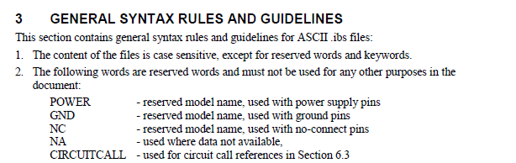
Define Reserved Model Names, Page 9
POWER – The terminal for this pin is connected to a source external to the [Component], that is referenced to a GND pin?
GND – The terminal for this pin is connected to a system reference node external to the [Component]?
NC – This pin is not connected in the [Component]?
NA – This pin has no model information currently available?
CIRCUITCALL – A Signal_pin in a [Circuit Call] references this pin?
Even better, move these
to the [Pin] section

Slide 8
Reference Node Clarification, Page 10
New line in GENERAL SYNTAX RULES AND GUIDELINES to clarify reference node:
…
11. Currents are considered positive when their direction is into the component.
NEW. All voltages are relative to the reference node of the real or simulated test fixture, except where otherwise stated.
12. All temperatures are represented in degrees Celsius.
13. Important supplemental information is contained in Section 9, “NOTES ON DATA DERIVATION METHOD”, concerning how data values are derived.

Slide 9
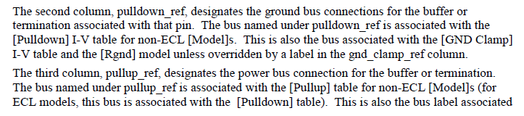
[Pin Mapping], page 23
From Radek:
  What is the relationship between pulldown_ref, and/or the gnd_clamp_ref bus declaration under the [Pin Mapping] keyword and the signal I/O reference node?
  Do we need to extend the [Pin Mapping] definition to cover signal I/O reference declaration?

Slide 10
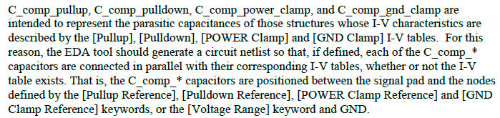
C_comp, page 33
Clarify last sentence?
Similar clarifications needed elsewhere.

Slide 11
Vinl and Vinh, pages 33,36
Specify references for Vinl and Vinh?
  [Model] and [Model Spec] Vinl/Vinh not even defined, other than comments in an example
  Clarification on page 10 (previous slide) might suffice.
  Need better definition for ECL/PECL

Slide 12
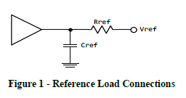
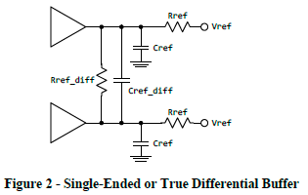
Figures 1-2, pages 33-34
Change ground symbol to ?
Show Vref as a voltage source symbol with two terminals?
Show buffer reference terminals?
Correct “dangling”

Slide 13
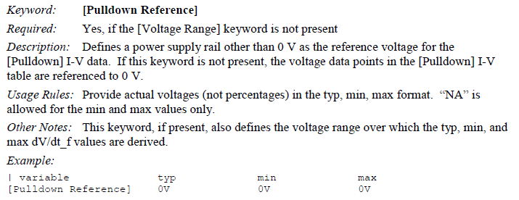
[Voltage Range], [* Reference], pages 49-51
Change Description to clarify that these are voltage values?
  Nodes and voltage values are mixed up.
Add figure showing terminals and supplies?
  Especially show what reference node of each supply is connected to.

Slide 14
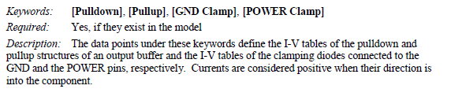
I-V table reference connections, page 53
[Pullup] source is referenced to a POWER pin?
[Pulldown] source is referenced to a GND pin?
For ECL [Pulldown] source is referenced to a GND or POWER pin?
[POWER Clamp] source referenced to?
[GND Clamp] source referenced to?
With [Pin Mapping] it may not be pins?

Slide 15
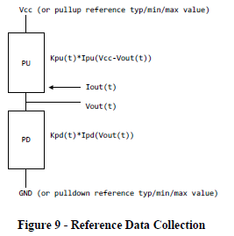
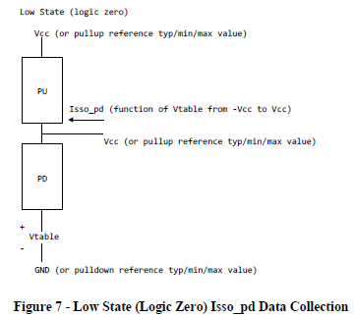
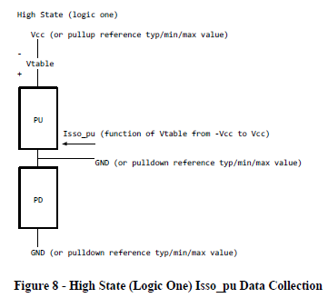
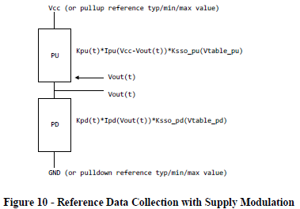
Figures 7-10, pages 57-59
Change Vcc to POWER?
Show them as terminals?
Show external sources in circuits?
[Pullup Reference]?

Slide 16
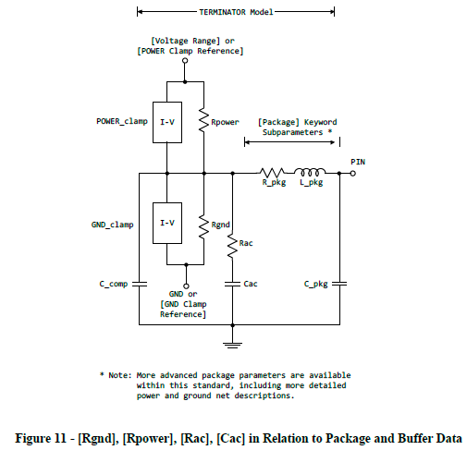
Figure 11, page 62
Change ground symbol to ?
Show reference terminals connected through POWER and GND pins to external sources at [POWER Clamp Ref] and [GND Clamp Ref].
Show other types?

Slide 17
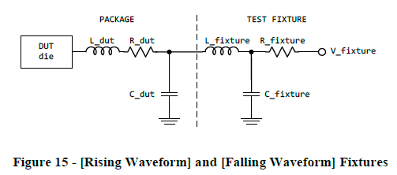
Figure 15, page 72
Dangling?
Only to show relationship of DUT & Fixture?

Slide 18
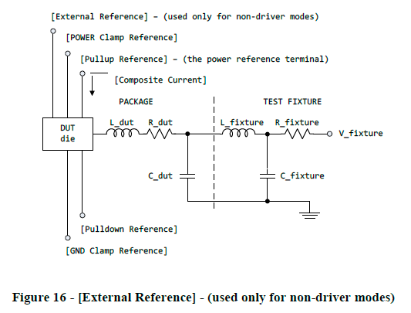
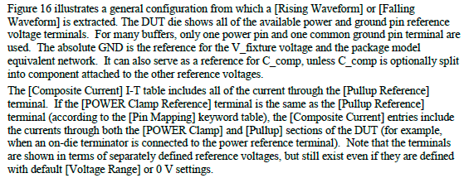
Figure 16, page 72
Change ground symbol to ?
Show all reference terminals connected through POWER and GND pins to external sources?
Clarify “absolute GND”
Clarify C_comp?
Clarify last sentence?
Separate diagram for ECL?
[Voltage Range]?

Slide 19
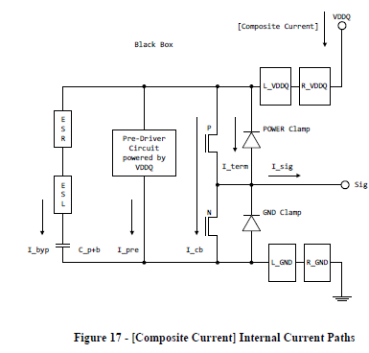
Figure 17, Page 73
Show all reference terminals connected through POWER and GND pins to external sources?
Show Sig terminal connected to test fixture load?
Is this DUT or DIA?
L_VDDQ & R_VDDQ are on-die

Slide 20
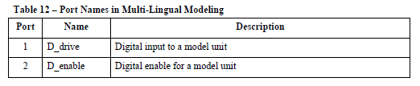
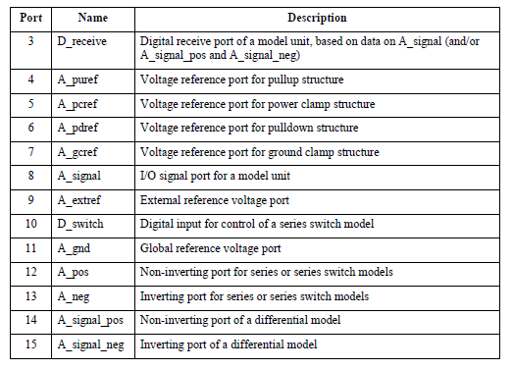
Table 12, pages 93-94
Clarify A_extref and A_gnd

Slide 21
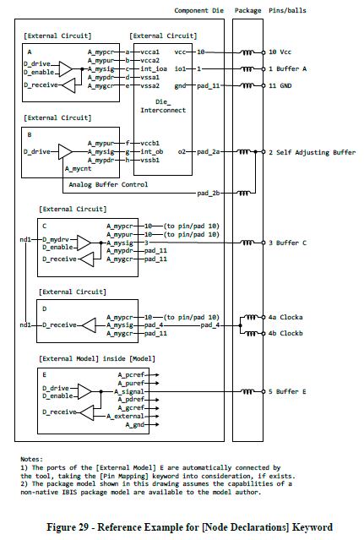
Figure 29, page 132
Is note 1 sufficient?
Confusing use of GND as a signal name here.
[Pin Mapping] can be used with [External Model] but not [External Circuit]?

